Slide 1

Python
1. VARIABLES

Slide 2
Set up your computer
Install Python
From command prompt python --version
Download and install latest version from https://python.org/
Install IDE (Integrated Development Environment)
Download and install Visual Studio Code from https://code.visualstudio.com/
Install Python Extension
Select Python Interpreter

Slide 3
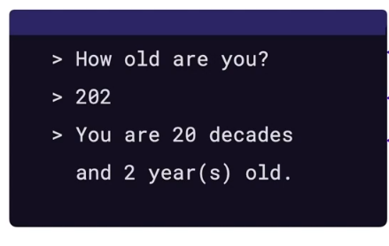
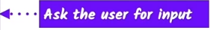
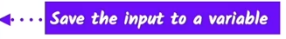
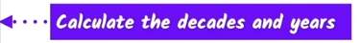
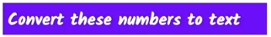
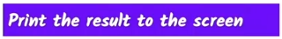
Sample Program Breakdown

Slide 4
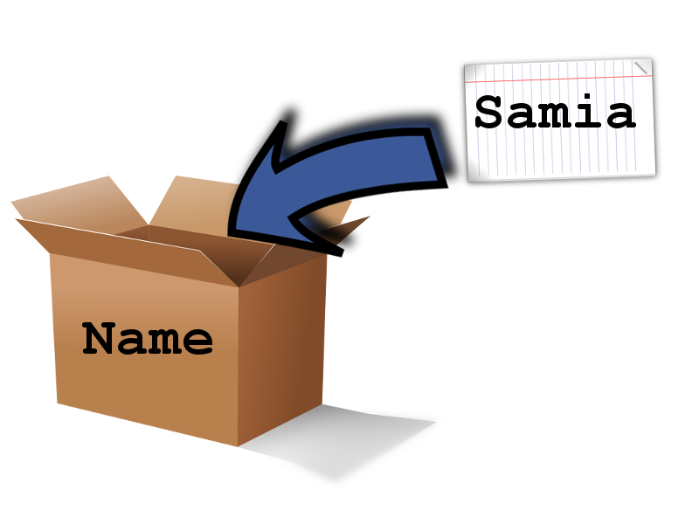
Print function and Variables
Print Function
print(“hello world”)
The command ‘print’ is a function
The text passed is an argument
Variables
name = “Samia”
Think of a box that can store data
Declared a variable called ‘name’
Assigned a value to the variable
Variable types: string, integer, float, boolean
In Python, variable types are inferred

Slide 5
Let’s Program
Task: Create a program which prints ‘Hello World’
Task: Create a program which calculates the area of a square
Math operators include +, -, *, /
Task!: Create a program which calculates the area of a rectangle
Task: Create a tax calculator
Concatenating strings
print(first_name + “ “ + last_name)
Converting data types
print("I am " + str(age) + " year's old")
str(), int(), float(), bool()
Input using the input function
name = input(“What’s your name?”\n)
Task: Create a program which calculates how old you are in decades
integer division //
modulus/remainder %

Slide 6
Additional Programming Challenges
Task!: Write a program where the user enters a restaurant bill total. The program should then display 2 amounts: a 15 percent tip and a 20 percent tip.
Task!: Write a Car Salesman program where the user enters the base price of the car. The program should add on a bunch of extra fees such as tax, license, dealer prep, and destination charge. Make tax and license a percent of the base price. The other fees should be set values. Display the actual price of the car once all the extras are applied.

Slide 7
Python
2. CONDITIONALS AND IMPORTS

Slide 8
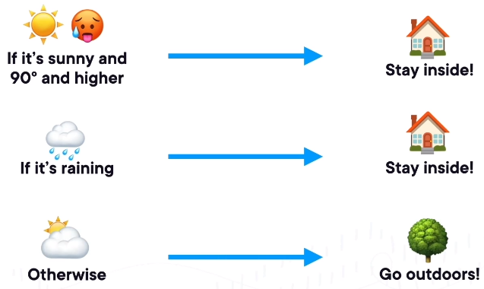
How to make a decision
A conditional statement, or if statement lets us make a decision in Python.

Slide 9
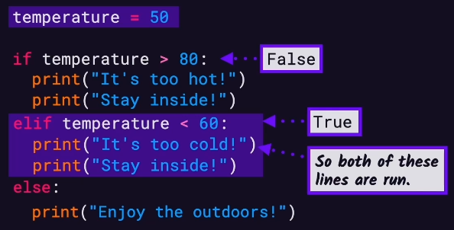
Comparators and If statement
< less then
<= less then or equal to
== equal to
>= greater then or equal to
> greater then
!= not equal
A code block is a piece of Python program text that is executed as a unit
Task!: Write a program where the user enters a password. If the password is correct,
print ‘Access granted’, else print ‘Access denied’

Slide 10
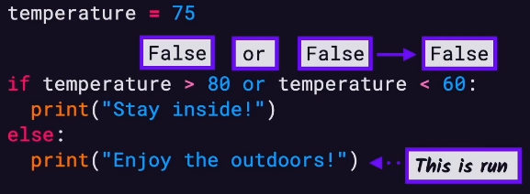
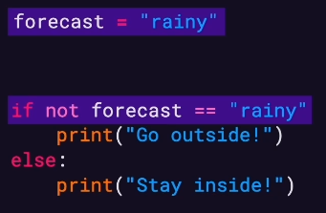
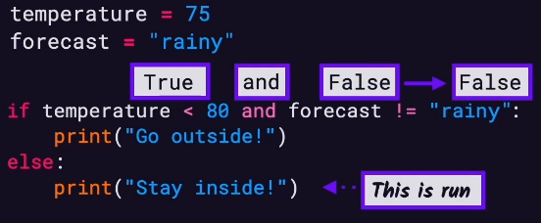
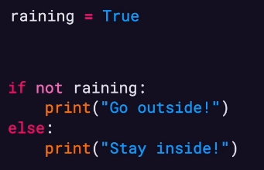
Logical operators – or, and, NOT
We can combine if statements using logical operators
Task!: Write a program where the users enters their gender and age. Suggest a suitable activity (50+ years or under).
Task: Create a Rock, Paper, Scissors game.

Slide 11
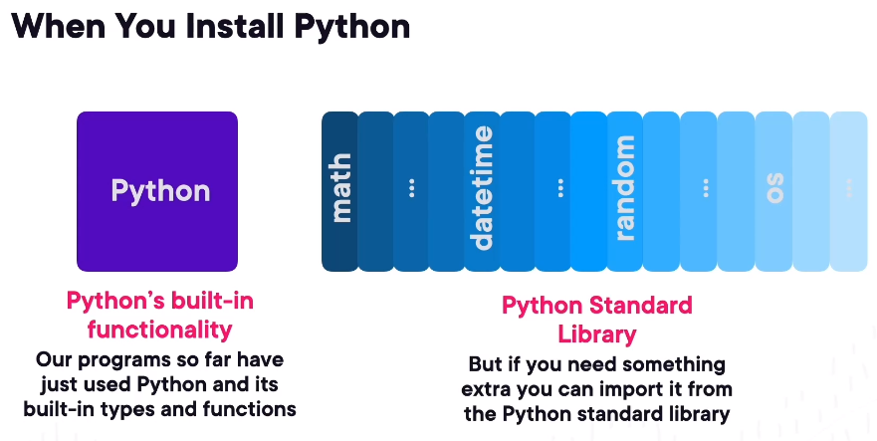
Importing modules
Search for Python Standard Library
https://docs.python.org/3/library/index.html
Import a module using the keyword import

Slide 12
Let’s program
Task: Create a game where the user has to guess a dice roll. We will need to import the random module and use the random.randint() function.
Task: Randomise the rock paper scissors game. We will need to use the random.choice() function.
Task!: Write a program where the user enters their test score from 0 - 100. Print A for 90-100. Print B for 80-89. Print C for 70-79. Print fail for 0-69.
Task!: Write a program that simulates a fortune cookie. The program should display one of 5 unique fortunes, at random, each time it’s run.
.

Slide 13
Python
3. LISTS AND LOOPS

Slide 14
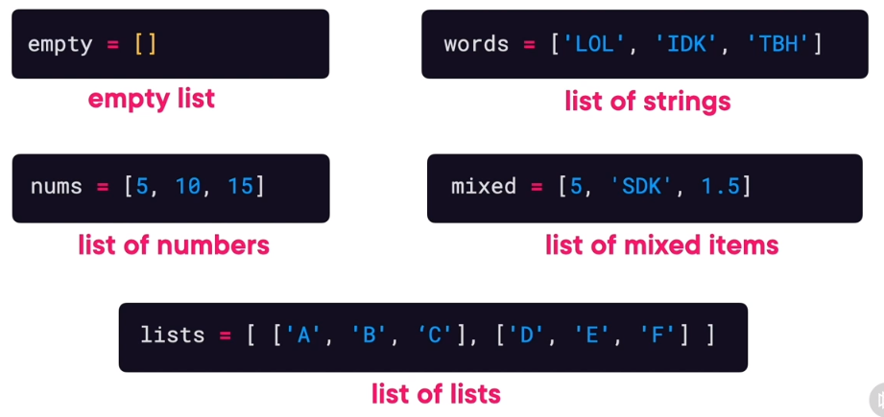
Lists
A list is a container of things

Slide 15
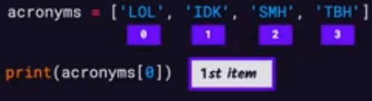
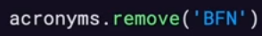
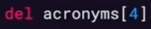
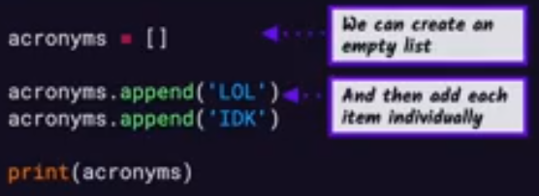
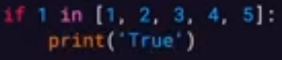
Working with Lists
An items index is it’s position
Creating a list with items in it
Remove item by value
Remove item by index
Creating a list and adding items
Check if an item exist in a list

Slide 16
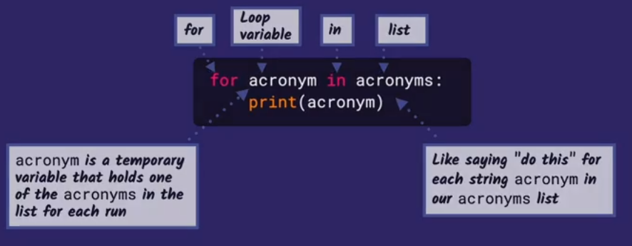
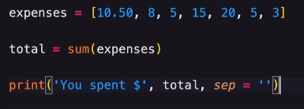
Syntax of For loop
Using a For Loop to iterate through a List
Calculating expenses using sum method
Print method with more arguments
Task!: Create a list of expenses and display the total

Slide 17
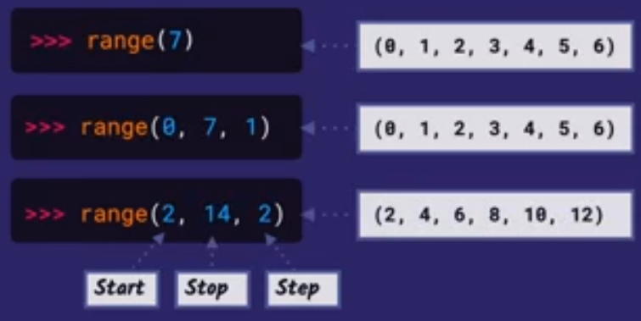
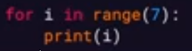
For Loops with range
Task!: Update the expenses program to allow the user to
enter 7 expenses
Task!: Update the expenses program to allow the user to
enter the number of expenses they would like to add
A for loop with the sequence generated by range()

Slide 18
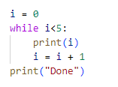
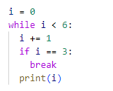
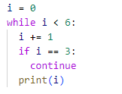
While loop, continue, break
Iterates while condition is true
break exits the loop
continue stops current iteration

Slide 19
Let’s program
Task!: Write a program that flips a coin 100 times and then tells you the number of heads and tails.
Task!: Write a program that counts for the user. Let the user enter the starting number, the ending number, and the amount by which to count.
Task!: Create a Guess My Number game. The pseudocode is as follows:
pick a number at random
while the player hasn’t guessed the number
let the player guess
congratulate the player
Task!: Modify the Guess My Number Game so that the player has a limited number of guesses. If the player fails to guess in time, the program should display an appropriate message.
Task!: Write a program where the player and computer trade places in the Guess My Number game. The player picks a random number between 1 and 100 that the computer has to guess.

Slide 20
Python
4. Dictionaries

Slide 21
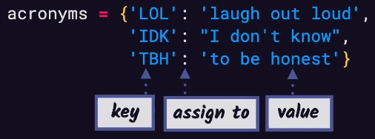
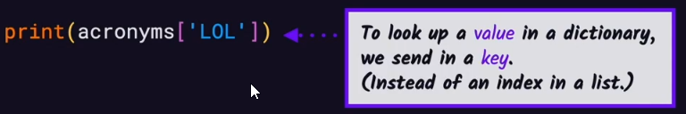
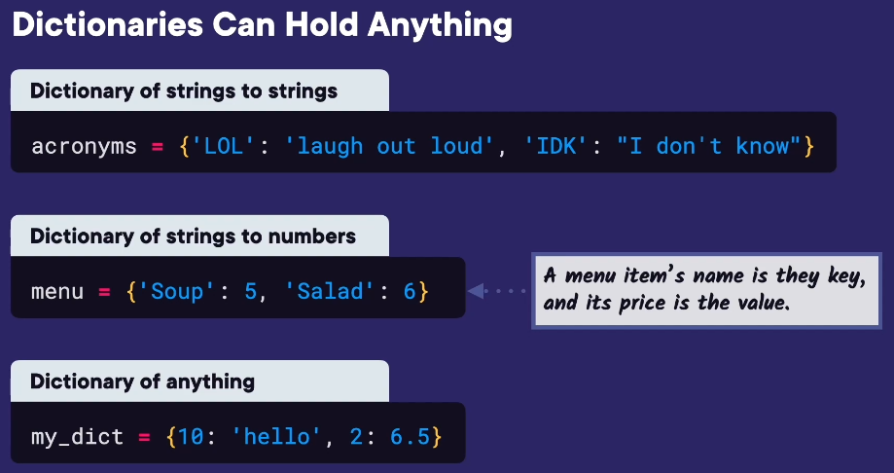
Dictionaries
Each item is known as a key-value pair

Slide 22
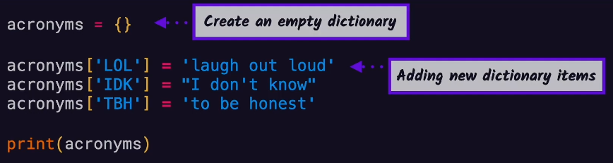
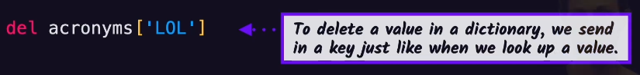
The get keyword will return None if the key does not exist
Task!: Create a movie schedule where the user can enter the name of a movie and get the show time

Slide 23
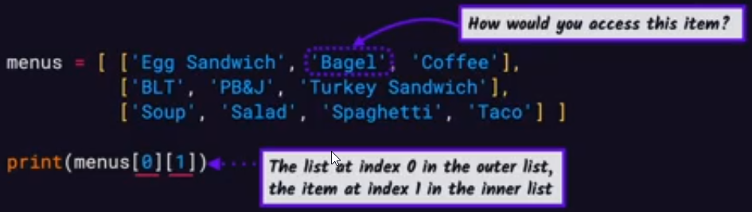
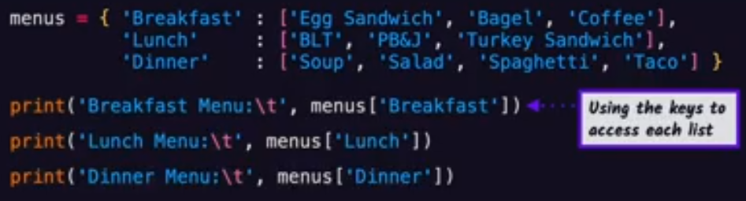
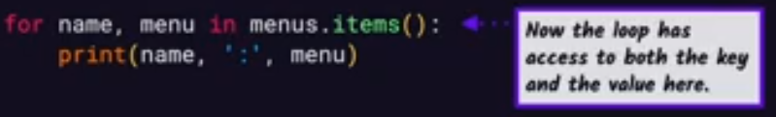
List of Lists
Dictionary of Lists

Slide 24
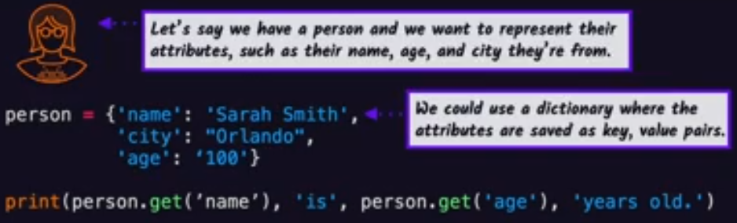
Using dictionaries to represent objects
Task!: Create a contacts list. It should store the number of contacts and the students. Each student should
have a name and email address. Print only the email addresses out.

Slide 25
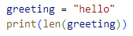
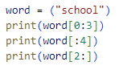
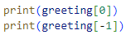
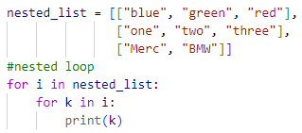
Bits and pieces
The len() function works with any sequence
Slicing a string
“sch”
“scho”
Access individual characters from a string
“hool”
Nested loops
The constant name is in all caps.
A tuple is similar to a list but is immutable
like a string (you cannot update a specific item)

Slide 26
Let’s program
Task: Create a Word Jumble game. Create a sequence of words, select a word at random, jumble the word, allow the user to guess the word
Task: Improve the Word Jumble game so that each word is paired with a hint. The player should be able to see the hint if they are stuck. Add a scoring system that reward players for solving a jumble without using the hint.
Task!: Create a program where the computer picks a random word and the player has to guess that word. The computer tells the player how many letters are in the word. Then the player gets five chances to ask if a letter is in the word. The computer can only respond with ‘yes’ or ‘no’. Then the player must guess the word.

Slide 27
Keep Programming
Task!: Create a program that prints a list of words in random order. The program should print all the words and not repeat any.
Task!: Write a Character Creator program for a role playing game. The player should be given a pool of 30 points to spend on four attributes: Strength, Health, Wisdom and Dexterity. The player should be able to spend points from the pool on any attribute and should also be able to take points from an attribute and put them back into the pool.
Task!: Write a Who’s Your Daddy program that lets the user enter the name of a male and produces the name of his father. Allow the users to add, replace and delete son-father pairs.
Task!: Improve the Who’s Your Daddy program by adding a choice that let’s the user enter a name and get back a grandfather. Your program should still only use one dictionary of son-father pairs.

Slide 28
Python
5. Functions

Slide 29
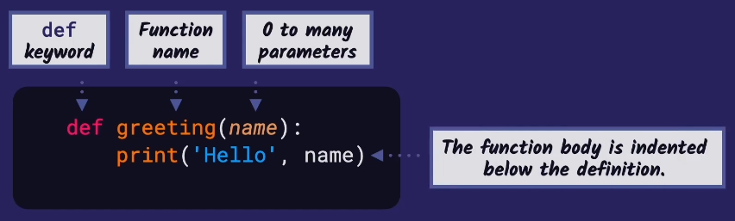
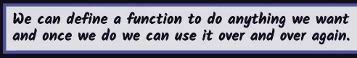
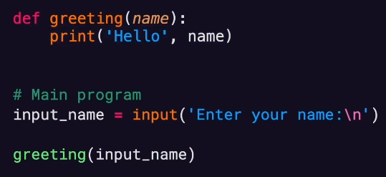
DEFINING AND USING A FUNCTION
Order matters! The function definition must come before it is used. This is the same as how a variable works.
Functions allow you to organize your code into logical units

Slide 30
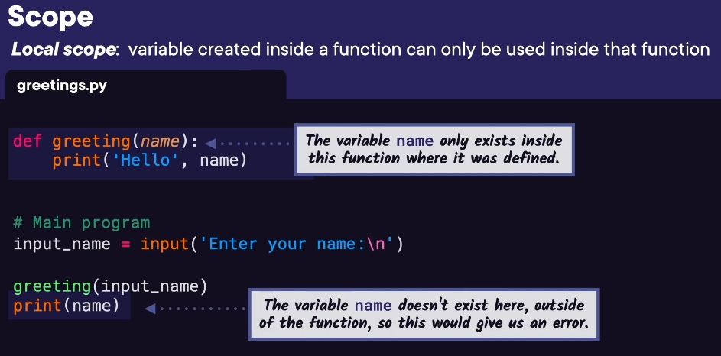
Local scope

Slide 31
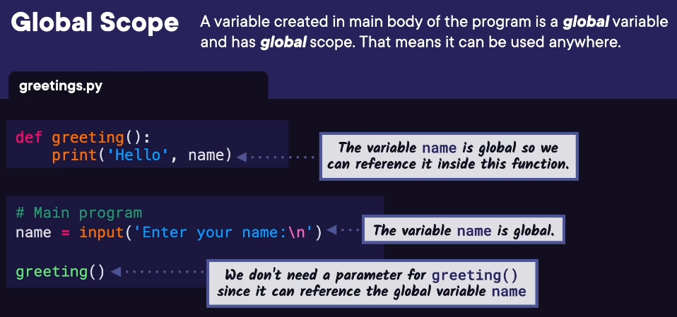
Global scope
Using global variables is messy

Slide 32
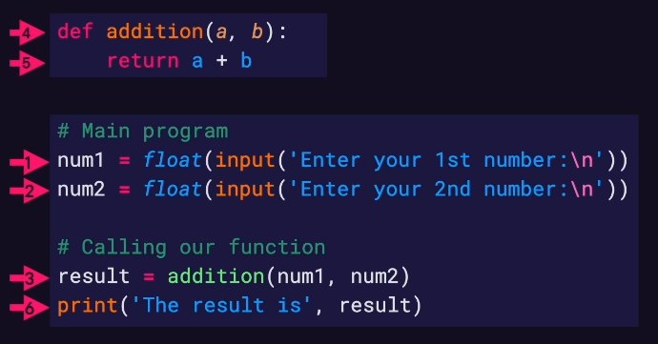
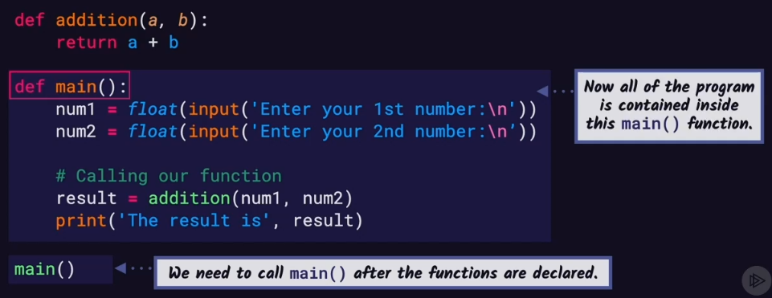
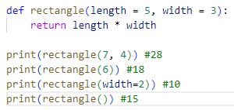
Function with return
A parameter is the variable listed inside the parentheses in the function definition. An argument is the value that are sent to the function when it is called.
Using default values in functions

Slide 33
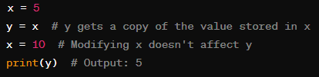
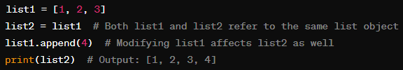
Value and reference types
Value Types: These are data types where the variable holds an actual value. When you assign a new value to a variable of a value type, it creates a copy of that value. Examples of value types in Python include integers, floats, booleans, and strings.
Reference Types (or Objects): In Python, most data types are objects. When you assign a variable to an object, you're actually assigning a reference to that object. This means that multiple variables can refer to the same object. Examples of reference types in Python include lists, dictionaries, sets, and custom objects.

Slide 34

Value and reference types
It's important to understand that in Python, variables hold references to objects rather than the objects themselves. When you pass variables to functions or assign them to other variables, you're passing or assigning references, not the underlying objects.
Understanding this distinction is crucial when dealing with mutable and immutable objects in Python. Immutable objects (like integers, floats, strings, and tuples) behave like value types, while mutable objects (like lists, dictionaries, and sets) behave like reference types because modifications to them affect all references to the same object.

Slide 35
Let’s program
Task!: Create a program which let’s user enter width and height of a triangle. Calculate the area in a function and return it to the user.
Task!: Modify the Guess My Number game by reusing the function ask_number()
Task!: Modify the Guess My Number game so that the programs code is in a function called main()
Task!: Create a dice roll game. Take player 1 name and player 2 name. Let them roll 2 dice and print the result.
Task: Create a Tic Tac Toe game
Task: Improve the function ask_number() so that the function can be called with a step value. Make te default value of step 1. (extends tic-tac-toe)
Task: Write a new computer_move() function so the computer is unbeatable. (extends tic-tac-toe)
Introduce Python Debugger

Slide 36
Python
6. Files and Exceptions

Slide 37





Exceptions
Syntax Errors occur because of typos
Exception occurred because key does not exist
Use a try/except block to catch exceptions
This ensures the program keeps running

Slide 38



The finally block will always execute
Raising an exception
Raising a custom exception
IOError – file doesn’t exist
IndexError - lists
KeyError - dictionary
NameError – variable or function not found
SyntaxError - typo
TypeError – operation or function applied to wrong type
ValueError – function receives argument with incorrect value
ZeroDivisionError – division by zero

Slide 39



Reading from files
Absolute path – path from top directory e.g. C:\Users\User\Documents\text.txt
Relative path – path relative to .py file which is attempting to access it e.g. text.txt
The with keyword ensures the file is closed
file.read() – return file content as string
file.readline() – returns next line of file as string
file.readlines() – returns list of strings
Instead of using file.readlines() we can just
loop over the file object

Slide 40


Writing to files
Task!: Create a program that displays a menu:
1.View acronym’s, 2. Find acronym, 3. Add Acronym, 4. Exit

Slide 41
Let’s program
Task: Create a Trivia Challenge game
Task!: Improve the Trivia game so that each question has a unique point value associated with it. The player score is the total points that were answered correctly.
Task: Improve the Trivia game so high scores are save to a text file.
Task: Create a Trivia game episode that tests a players knowledge of Python.

Slide 42
Python
7. Classes and Objects

Slide 43


Classes and objects
Object Orientated Programming (OOP)
A class is a template which can be used to create objects.
The initialize method must have a self parameter.
This refers to the current object. This is known as a constructor.
The other parameters are the attributes we want to initialize.

Slide 44

Class methods
A class method is a function that belongs to a class
Class methods must have self as first parameter
Import a class using:
from employee import Employee
employee is the file name and Employee is the class name
Task!: Create a company payroll program
A module is a file containing Python code. The code in a
module can consist of Python statements, function definitions,
class definitions, and variable assignments.
Benefits of modules: file-based organisation, namespace
Isolation, code reusability, importing modules.

Slide 45

Class Attributes and Static Methods
A class attribute or static method is associated with
the class, not the object
If the class is a template, an object is an instance of
that template, think of a class attribute as a post it note
stuck to the template.
The self keyword is not used with static attribute or method
They are accessed using the class name, not the objects name.
This means they are available before an object is created.

Slide 46


Private attributes and private methods
Private attributes and methods are only accessible
from within the class.
They are used for the internal workings of the class.
Encapsulation – wrapping of data into a single unit
Private access modifiers further enforce encapsulation
(only relevant attribute and methods are exposed
externally)

Slide 47

Properties
Control access to a private attribute by creating a property
@property decorator is the getter
@name.setter decorator is the setter

Slide 48
Let’s program
Task!: Create a Critter Caretaker program. The user should be able to listen, feed or play with the critter.
Task!: Improve the critter program by allowing the user to decide how much food to feed the critter and how long they play with the critter. These values should effect how fast the critter’s hunger and boredom levels drop.
Task!: Write a program that simulates a television by creating it as an object. The user should be able to enter a channel number and raise or lower the volume. Make sure that the channel number and volume stay with valid ranges.
Task: Create a “backdoor” in the Critter Caretaker program that shows the exact values of the of the objects attributes. Use a secret selection in the menu to display the attributes. (Hint: add the special method __str__() to the Critter class).
Task!: Create a Critter Farm program by instantiating several Critter objects and keeping track of them through a list. Mimic the Critter Caretaker program but the user is required to care for the entire farm. Each menu item should allow the user to perform some action for all of the critter. Give each critter a random starting hunger and boredom level.

Slide 49
Python
8. Classes Inheritance

Slide 50




Relationships in object orientated programming
Base class can be called the parent class
Derived classes can be called the child classes

Slide 51



Inheritance
Lets us model real-world relationships
Allows for code reuse

Slide 52


Method overriding
Initialise method is inherited
Method overriding is where the parent and child class
have the same method name
Can use the super() keyword to access parent method
Task!: Company Payroll with inheritance. Employees to
salary based, hourly based or commission based

Slide 53
Let’s program
Task!: Create a Snowball Fight game which allows two human players to battle each other. Options to include move forward, move backward, make a snowball and throw a snowball.
Task!: Extend the Snowball Fight game to include an option to play against the computer.

Slide 54
What else?
Sorting algorithms: bubble sort, merge sort, insertion sort
Searching algorithms: linear search, binary search
GUI development: Tkinter is the standard GUI toolkit for Python. It is included with most Python installations.
Relational databases: MS SQL, MySQL
Graph and Tree traversal
Machine Learning
Design Patterns

